Slide 1
Case Study: How does a bike-share navigate speedy success?
Target Audience: Cyclist Senior Team
Last Updated: 05-10-2024

Slide 2
Background
Cyclistic has a bike ride sharing plan in which bikes can be unlocked from one station and returned to any other station in the system anytime.
Cyclistic has flexible plans: single-ride passes, full-day passes, and annual memberships
Customers who purchase single-ride or full-day passes are referred to as casual riders. Customers who purchase annual memberships are Cyclistic members

Slide 3
Objective
WHAT
Find out how casual riders are different than members
Design strategy for converting casual riders in members

Slide 4
Objective
Why
Cyclistic’s finance analysts have concluded that annual members are much more profitable than casual riders
Maximizing the number of annual members will be key to future growth.
Rather than creating a marketing campaign that targets all-new customers, Current casual members can be converted to members for maximum profitability while minimizing cost

Slide 5
Objective
How
Provided are data from April, 2020 to March, 2021 (FY 21) for Country month wise
Ride ID, Ride Type, Started details, Ended details, Type of Riders etc. details are provided

Slide 6
Data Cleaning
Removed White spaces before and after every string field
Merged all monthly data combined into one database
Removed rides which started time is more than ended time
Removed NULL records
In total 203,239 or 5.83% data records were bad and removed, which indicates 94.17% of total recorded data was good. Total 3,277,912 data records were analyzed

Slide 7
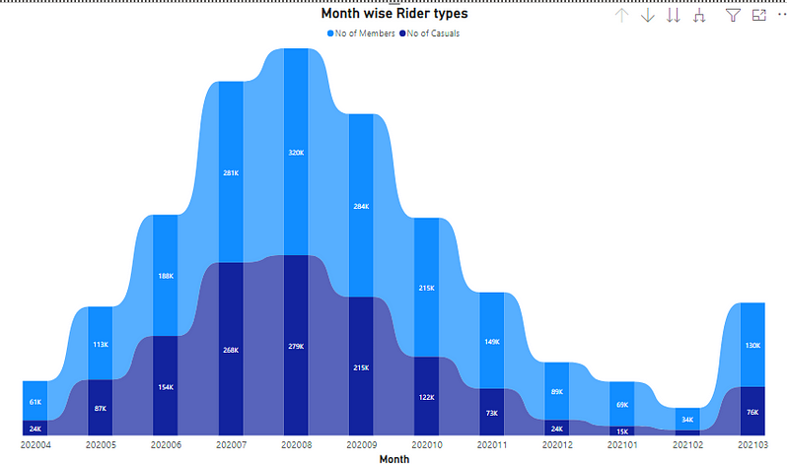
Data Analysis
August was busiest followed by July and September
Approx 50% rides (1.6 M) taken in August, July and September month
Approx 19% rides (600k) taken in August Month only

Slide 8
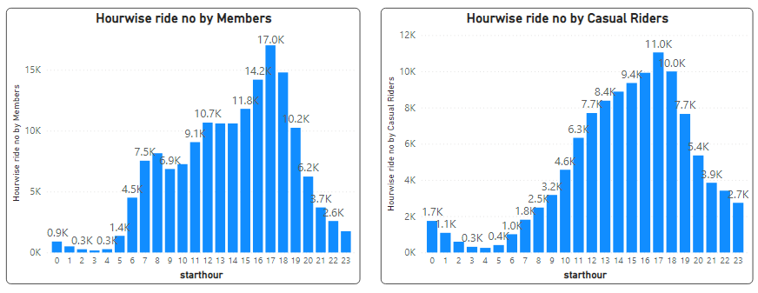
Data Analysis
Casual riders graph and member graphs show same distribution but members graph has two peaks each at 8 AM and 5 PM, which is close to daily work commute time, this shows that members are using their rides for commuting

Slide 9
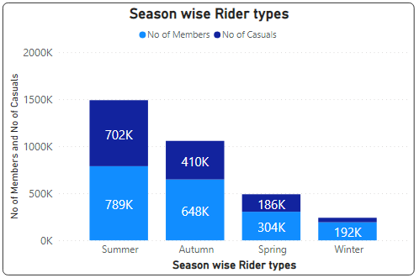
Data Analysis
Most people use cycle service in Summer and least in Winte.
Members tend to use cycles more consistently throughout the year (75% decline from 789K to 192K rides) than Casuals (89% decline from 1490K to 240K)

Slide 10
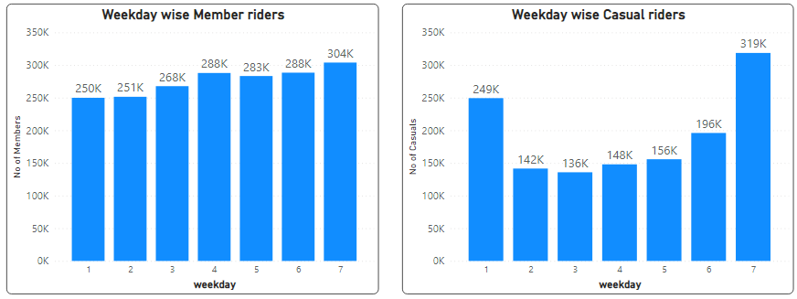
Data Analysis
General increase of bike rides from Sunday to Monday for both Members and Casuals
Members graph is showing consistency in ride no's, not changing much between weekends and weekdays, while casuals graph is not consistent thorough out the week, it shows two spikes on weekends, Sunday and Saturday. Which supports earlier theory of members tend to use bikes for daily activities or commutes and casuals using more on weekends for leisure activities or evening strolls on beach or any special occasions

Slide 11
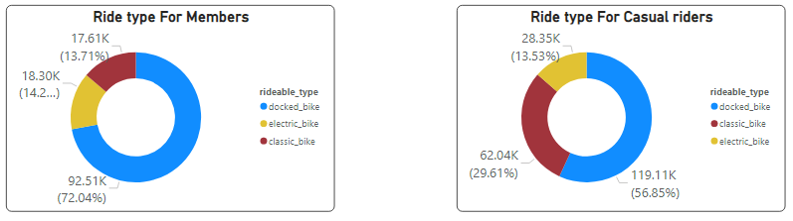
Data Analysis
Preference of rides for members: (1) Docked bike (2) Electric bike (3) Classic bike
Preference of rides for casual riders: (1) Docked bike (2) Classic bike (3) Electrical bike

Slide 12
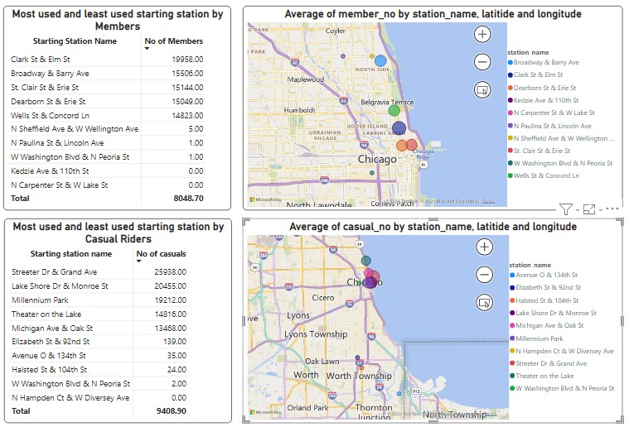
Data Analysis
Near to sea locations are preferred by all riders. In that too, Casual riders are using the bikes nearer to seashore, that can be explained by the weekend rides to beach or nearby locations by casual riders.

Slide 13
Recommendations
Based on behavior of casuals riding bikes on weekends, We can start some promotions on membership that offers discounted rates on weekends
(2) We can target ad campaigns for offers on top 5 station for casuals, that will ensure maximum reach of ads in minimum cost
(3) Casuals riding pattern shows peak timing from 5–7 PM, we can offer special discount on rides from 5–7 PM for members, that will attract more casuals to buy membership

